Slide 2
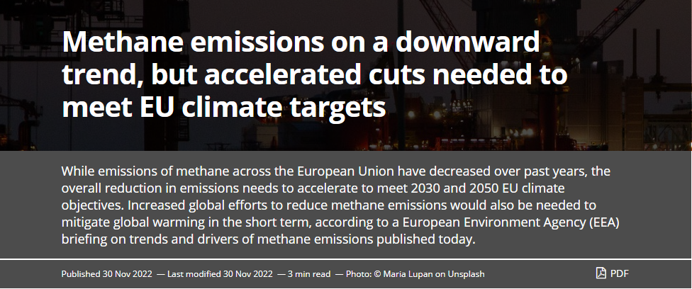
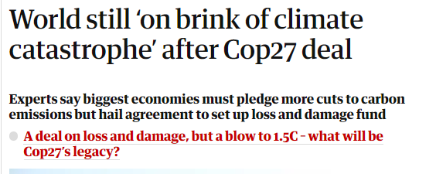
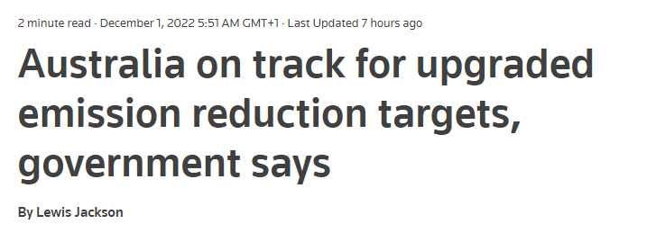
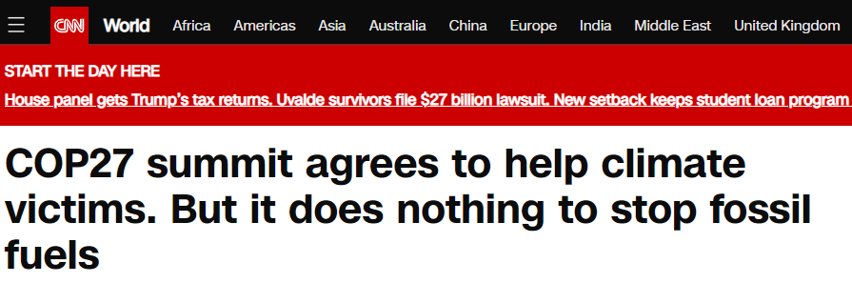

Slide 3

WORLD ENERGY SUSTAINABILITY
MAXIMILIANO TABÓ

Slide 4

Based on many papers, avoiding the worst effects of global warming will require us to source at least 85 percent of renewable energy.
And the question is: Where are we right now?

Slide 5
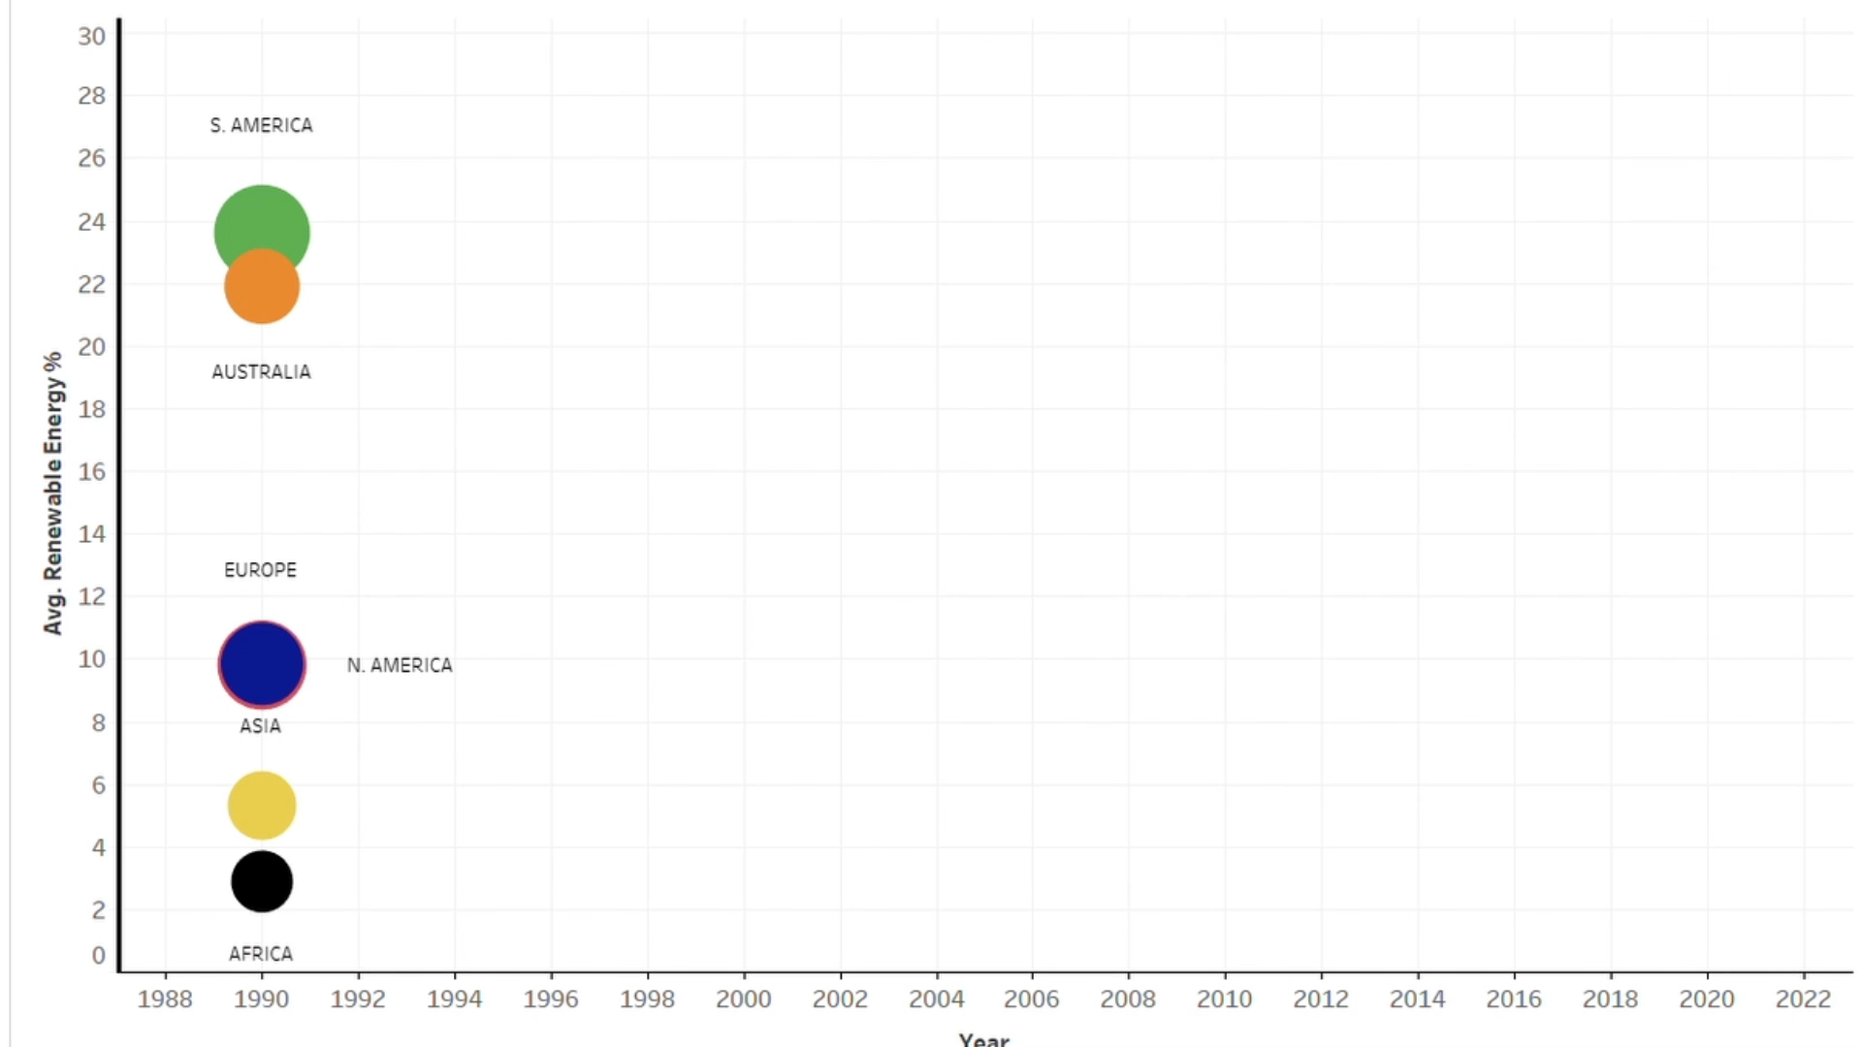
Renewable Energy % per Continent
Year

Slide 6
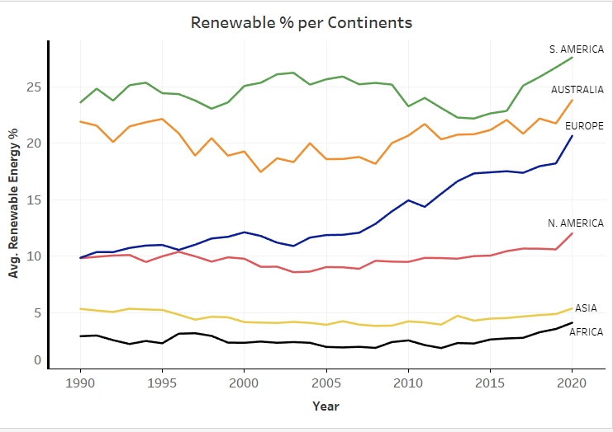
Notes:
ergdsfgsdgsdfgsdfgsgsdffgsdfgsdfg

Slide 7
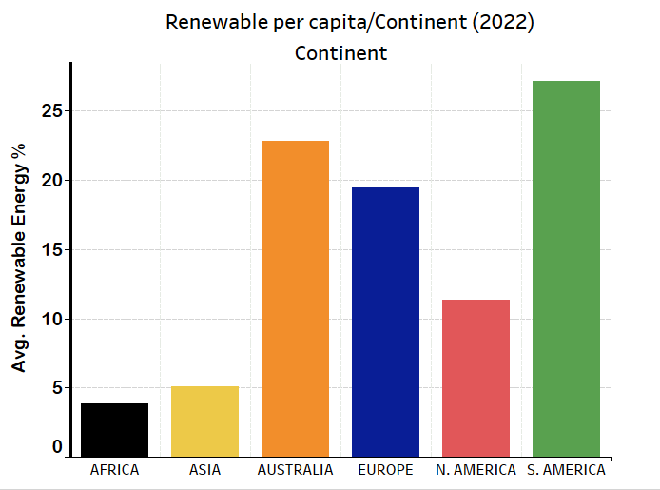
Renewable Energy %
per Continent (2020)

Slide 8
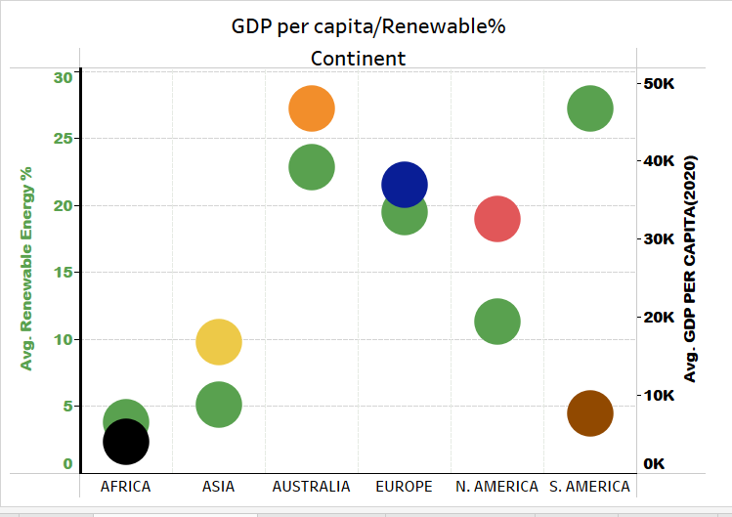

Slide 9
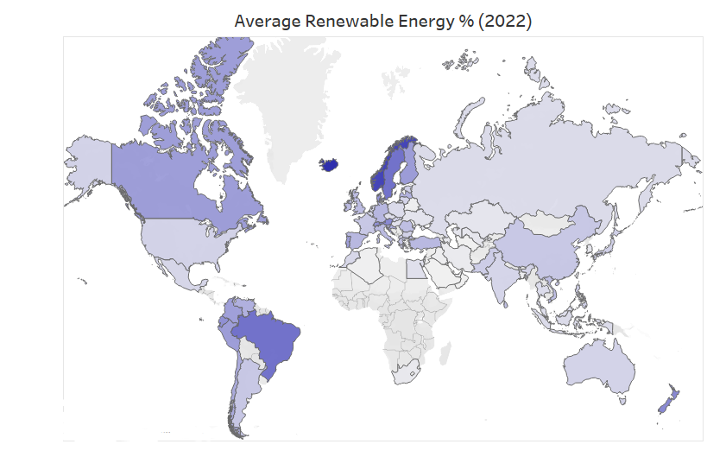
Renewable Energy % (2022)

Slide 10
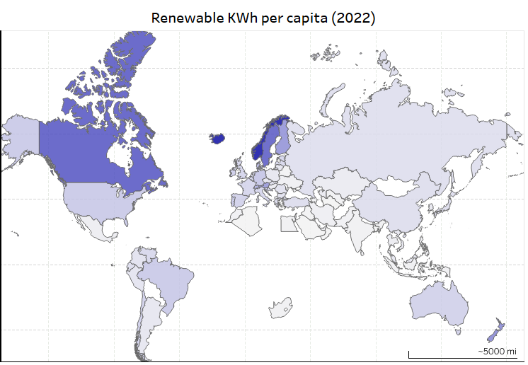

Slide 11
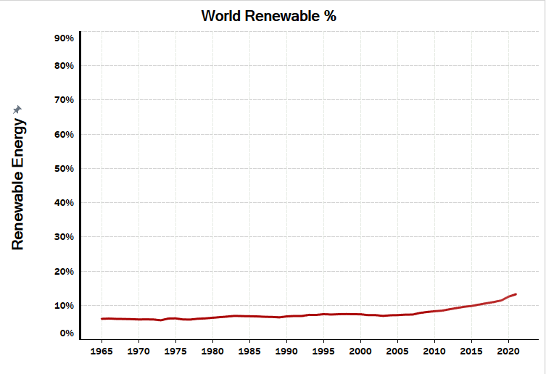

Slide 12
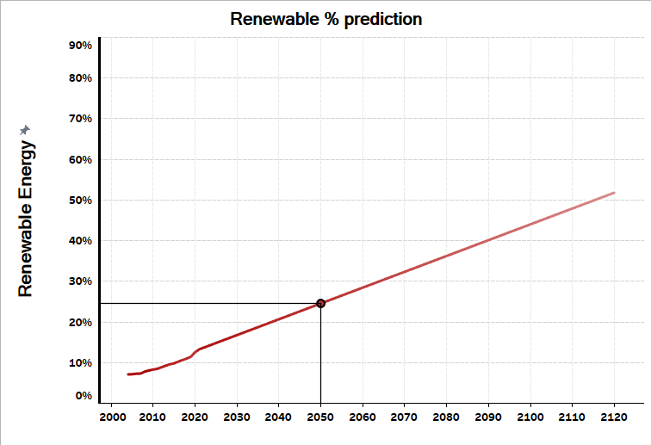
25%

Slide 13
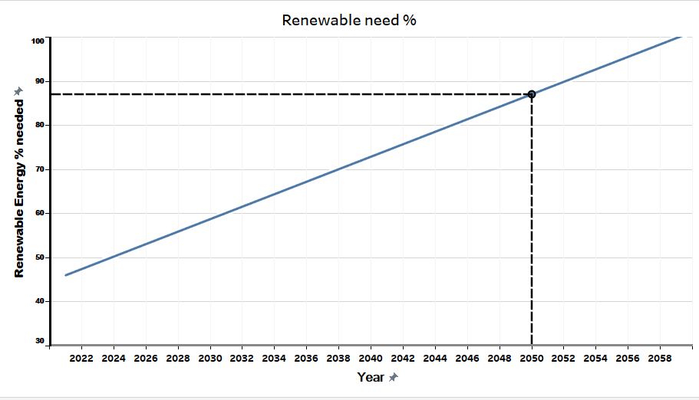
3,4 Times

